Slide 1
Market structure
Module 3

Slide 2
Market
Market is a term which is commonly used for a particular place or locality where goods are bought and sold. According to Prof. Samuelson, “A market is a mechanism by which buyers and sellers interact to determine the price and quantity of a good or service.” Based on competition, the market structure has been classified into two broad categories:
1. Perfectly competitive. (Perfect Competition)
2. Imperfectly competitive. (Monopoly, Monopolistic competition and Oligopoly)

Slide 3
Perfect Competition
Perfect competition is defined as a market structure in which an individual firm producing homogenous commodities cannot influence the prevailing market price of the product on its own.
Perfect competition is a market structure characterized by complete absence of rivalry among individual firms.

Slide 4
Features of Perfect Competition
1. Very Large Number of Buyers and Sellers
There are so many buyers and sellers that no individual buyer or seller can influence the price of the commodity in the market. He is a price-taker having no bargaining power in the market.

Slide 5
2. Homogeneous Product
Firms in the market produce a homogeneous product. Homogeneity of a product implies that one unit of the product is a perfect substitute for another.
3. Free Entry or Exit of Firms
The industry is characterized by freedom of entry and exit of firms. In a perfectly competitive market, there are no barriers to entry or exit of firms. Entry or exit may take time, but firms have freedom of movement in and out of an industry.
4. Perfect Knowledge
Firms have all the knowledge about the product market and the factor market. Buyers also have perfect knowledge about the product market.

Slide 6
5. Perfect Mobility of Factors of Production
The factors of production can move easily from one firm to another. Workers can move between jobs and between places.
6. Absence of Transportation Cost
All goods are produced locally. Transportation costs are zero.
7. Perfectly elastic demand curve
At existing price seller can sell any amount of commodity.
:: Imaginary or hypothetical market situation ::

Slide 7
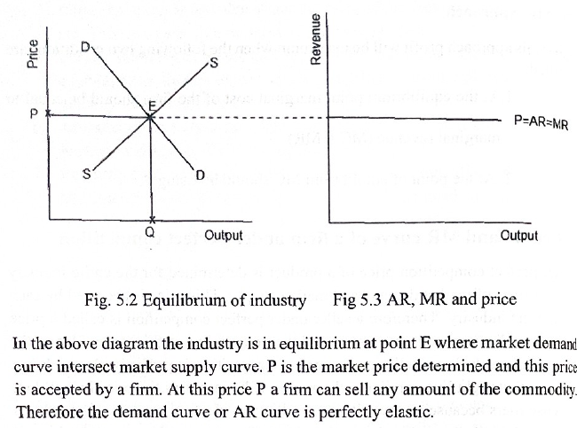

Slide 8
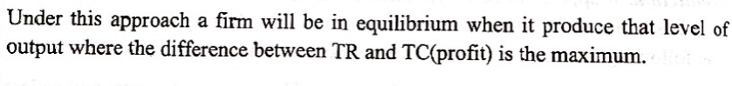
Equilibrium of a Competitive Firm
Under any market situation a firm is in equilibrium when it gets maximum profit.
There are two approaches to find the profit maximizing level of output.
TC, TR Approach. 2. MC, MR Approach.
TC, TR Approach.

Slide 9
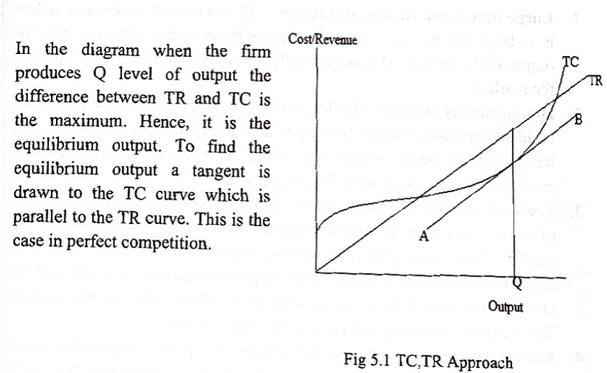

Slide 10
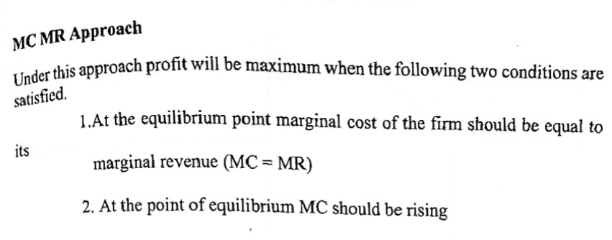
Mc, Mr Approach

Slide 11
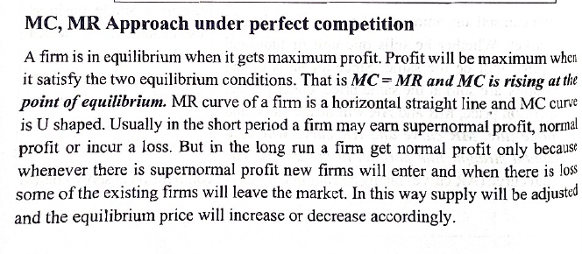

Slide 12
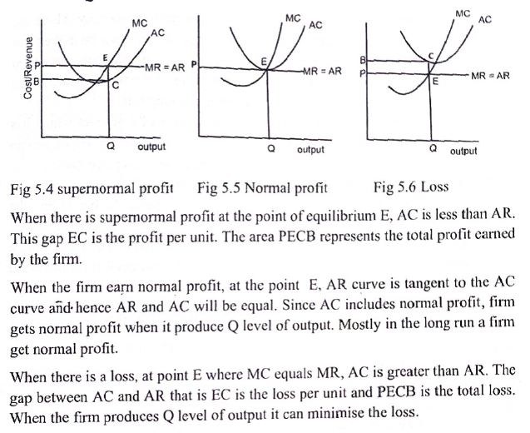

Slide 13
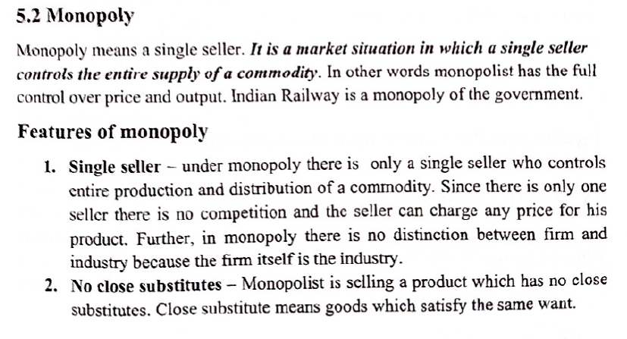
monopoly

Slide 14
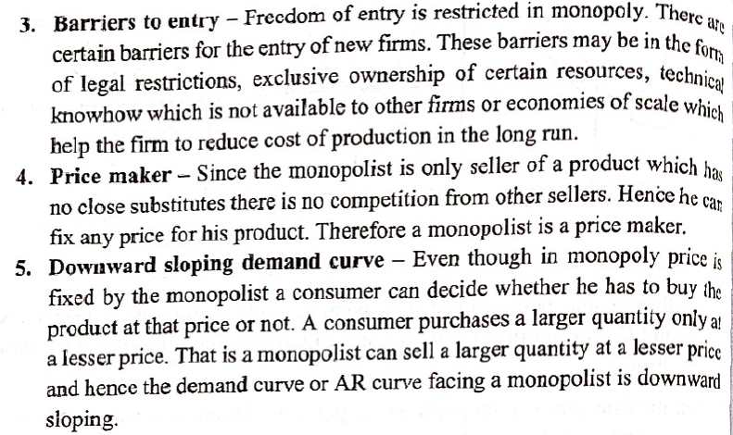

Slide 15
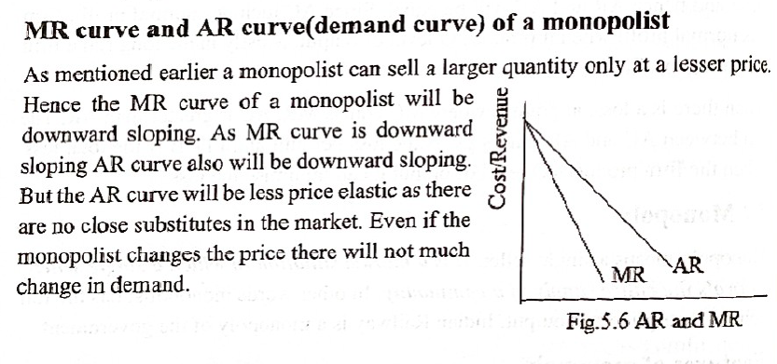

Slide 16
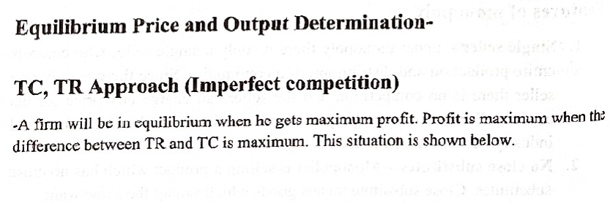
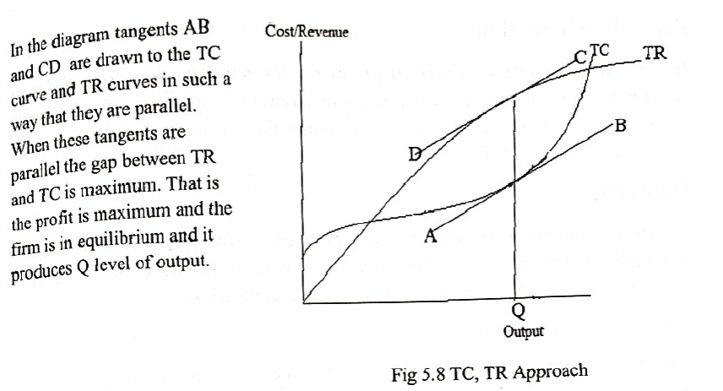

Slide 17
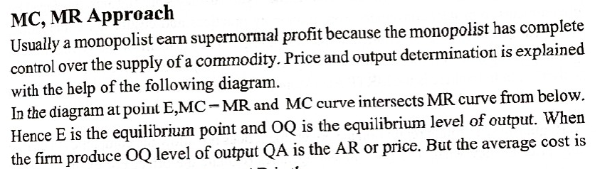
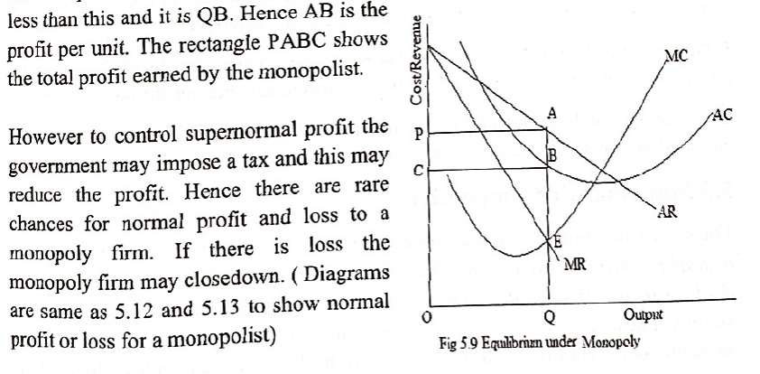

Slide 18
Monopoly
A market situation in which a single seller controls the entire supply of a commodity.
The monopolist has full control over price and output. E.g. Indian Railway.
Is Luxottica – a Monopoly ?

Slide 19
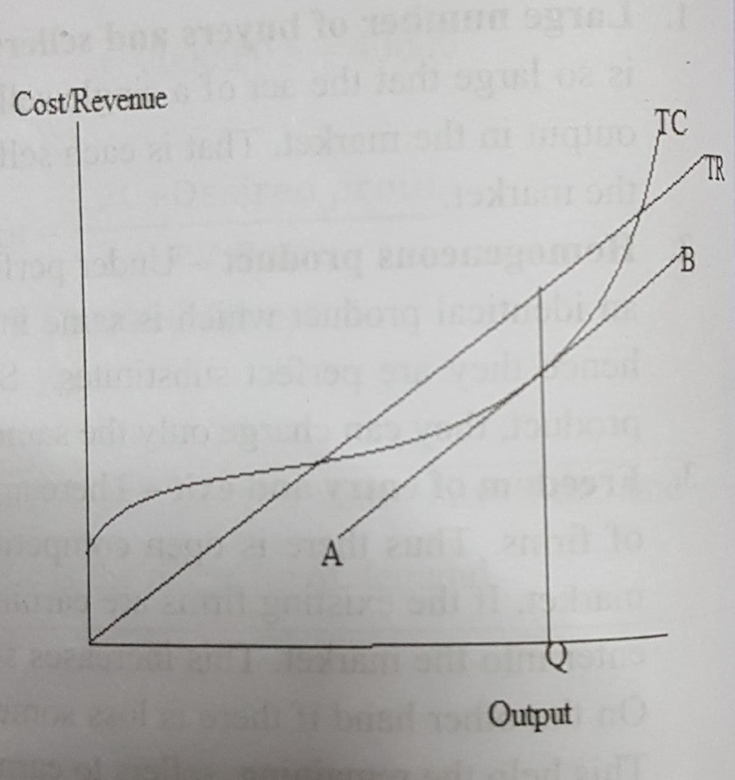
Equilibrium of a firm
Under any market situation, a firm is in equilibrium when it gets maximum profit
TC, TR approach
Maximum profit is when difference
between TR and TC is maximum

Slide 20
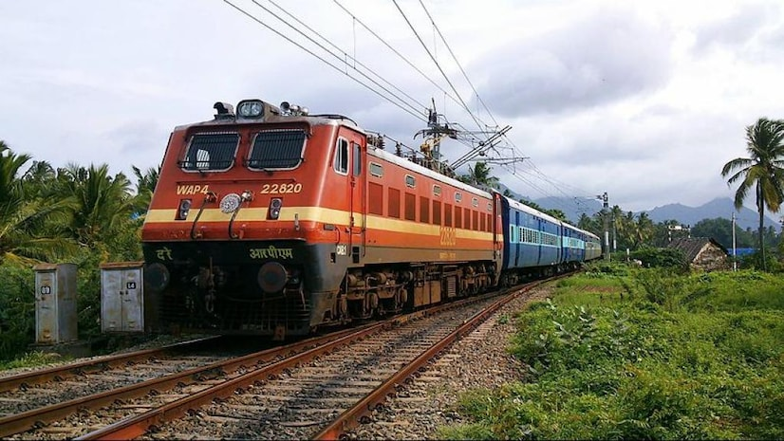
Monopoly: features
single seller: single seller controls entire production and distribution—no competition, any price can be charged—firm itself is the industry
no close substitutes
barriers to entry: entry to market is restricted—legal restrictions, exclusive ownership of resources, technical knowhow not available to other firms
price maker
-downward sloping demand curve: consumer still decides whether he should buy or not
Notes:
LEXOTICA IS A

Slide 21
Regulation of monopoly (Gregory Mankiw)
Increasing competition with Antitrust Laws
-these are statutes to protect consumers from monopoly practices and ensure fair competition
-Antitrust laws allow govt. to prevent mergers, and to breakup companies
MRTP Act in India (Monopolies and Restrictive Trade Practices) controls monopolies
Regulation
-regulates price e.g. electricity, power
-does not allow companies to charge any price they wish
Public ownership
-govt. becomes the owner

Slide 22
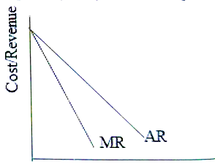
Demand Curve under Monopoly
A monopolist can sell a larger quantity only at a lesser price. Hence the MR curve of a monopolist will be downward sloping. As MR curve is downward sloping AR curve also will be downward sloping.

Slide 23
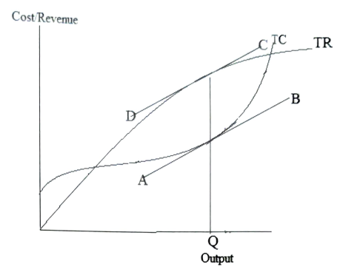
TC, TR Approach

Slide 24
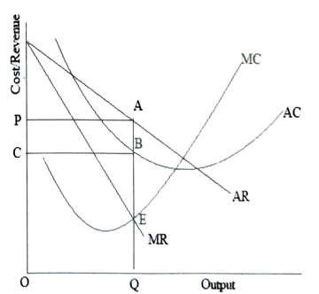
MC, MR Approach
Equilibrium under Monopoly Under monopoly, for the equilibrium and price determination there are two different conditions which are: 1. Marginal revenue must be equal to marginal cost. 2. MC must intersect MR from below

Slide 25

Dumping
It means a monopolist sells his product at a higher price in the home market and lower price in the international market.
Price Discrimination
lt is the act of charging different prices for the same product from different consumers.
For example, a doctor charges different fees from poor and rich patient
for electricity low rates are charged for domestic consumption and high rate for commercial consumption.
Notes:
CHINA TOYS

Slide 26
Monopolistic competition
A market situation in which there are large number of buyers and sellers dealing in a differentiated product
Combination of perfect competition and monopoly
Products produced by different sellers are not identical but close substitutes
e.g. different brands of soap
Product of each seller has a unique feature, so he has a monopoly on his product, but products are close substitutes and there are large no. of buyers and sellers

Slide 27
Monopolistic competition: Features
Large no. of buyers and sellers: Not as large as in perfect competition- each buyer represents an insignificant part of total
Product differentiation: Each product has a unique feature that gives it monopoly – colour, shape, quality, packing .
Selling cost: close substitutes => acute competition, thus expenditure on advertisement and sales promotion is high
Freedom of entry and exit: new firms can enter, loss making firms can leave industry at any time
Imperfect knowledge: info about market conditions –price, quality, cost not uniformly available

Slide 28
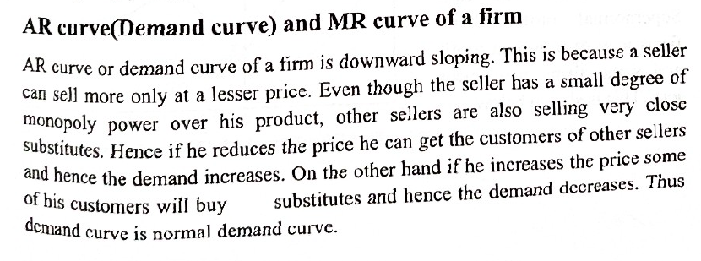
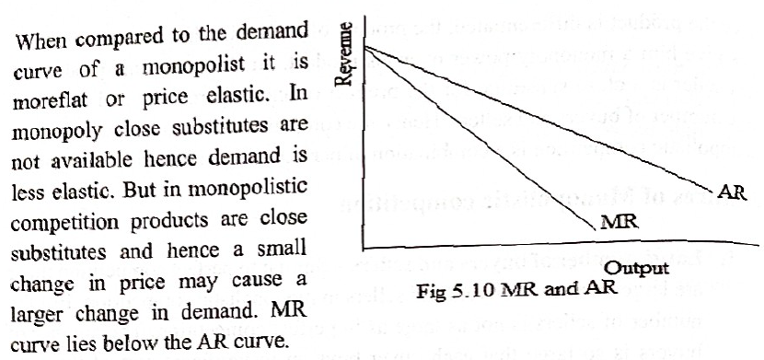

Slide 29
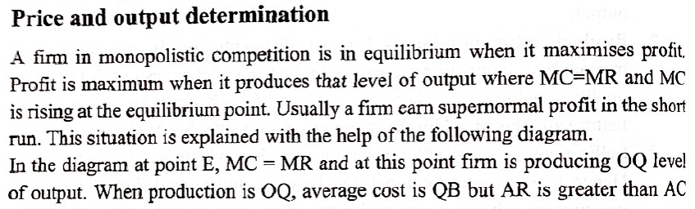
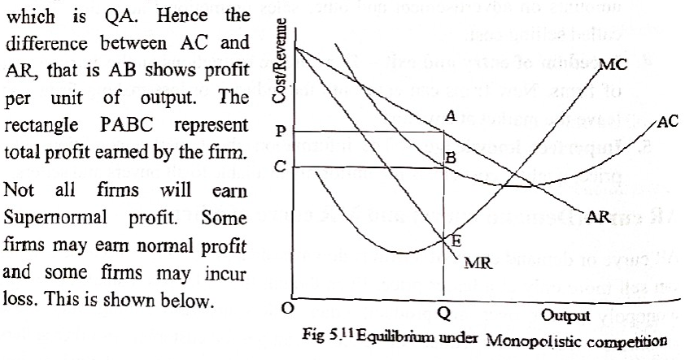

Slide 30
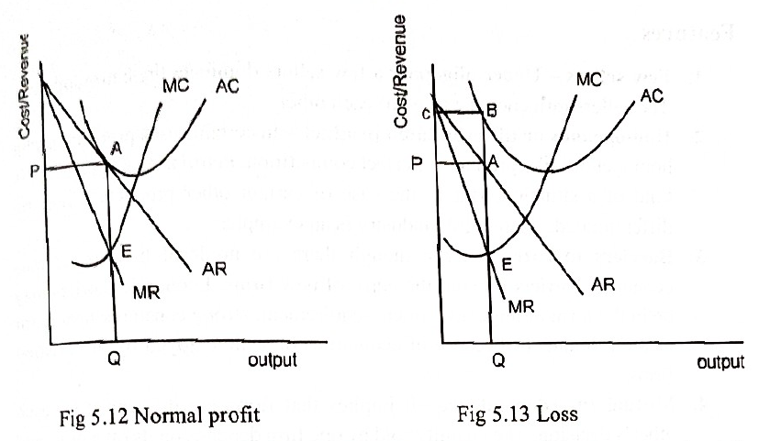

Slide 31
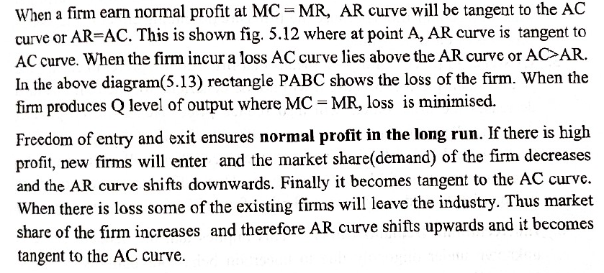

Slide 32
Oligopoly
Market situation in which there are few sellers selling either a homogenous or differentiated product
e.g. aviation industry, telecommunication industry

Slide 33
Oligopoly: features
Few sellers: Few sellers dominate the entire industry; influence price of each other
Homogenous/differentiated product: products may be homogenous in some cases e.g. petrol, and differentiated in others e.g. automobiles
Barriers to entry: No legal barriers, but economic barriers like huge investment requirement, strong consumer loyalty to existing brands, etc

Slide 34
Mutual interdependence: influenced by each other’s decision
Existence of price rigidity: Firms prefer not to change price, as it will not be beneficial
Indeterminate demand curve: Uncertain behaviour patterns. Demand is not stable as each firm keeps an eye on its rivals to change strategies

Slide 35
Kinked demand curve
Developed by Paul M Sweezy
Explains price rigidity under oligopoly
Assumptions:
If a firm increases its price others will not
If a firm decreases its price, others will

Slide 36
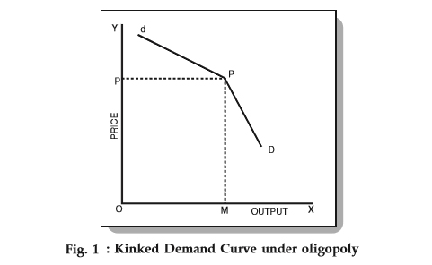

Slide 37
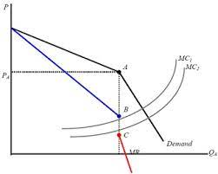
The kink at point A creates a discontinuity in the MR curve
MR remains unchanged between points B and C
Even if cost increases and MC shifts from MC2 to MC1, there will be no change in equilibrium price and quantity

Slide 38
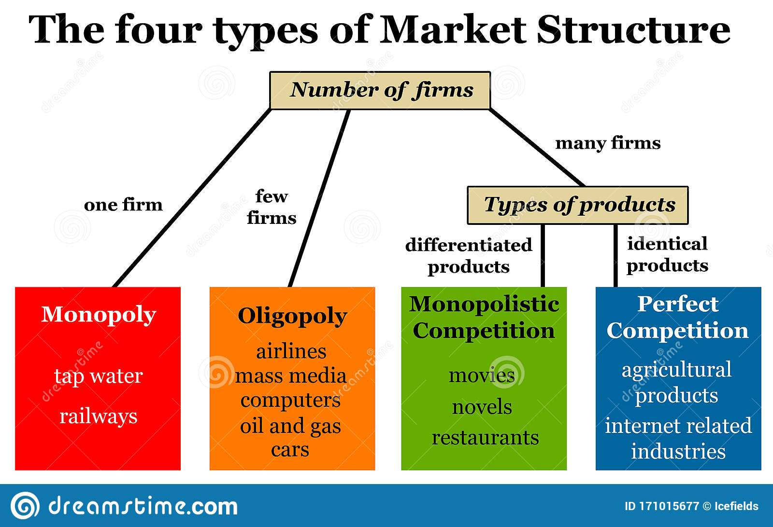

Slide 39
Collusive oligopoly
To avoid price war and loss, firms enter into an agreement regarding uniform price and output. This is known as collusion.
A situation in which two or more firms jointly set their prices or output, divide the market among them or make the business decisions
helps preventing uncertainties, entry of new firms, strengthens bargaining power of firms against buyers
Collusion can be formal/tacit

Slide 40
Non-price competition
Oligopoly involves tight competition
Trying to increase market share through price leads to price war; not effective
Thus, resort to non-price competition to increase sales
Competition between companies that focuses on benefits, extra services, good workmanship, product quality, etc.
It is a marketing strategy that includes sales staff, sales promotions, free gifts, coupons, advertising

Slide 41
Two main branches of non-price competition
- product differentiation (packing, colour, smell, quality)
- advertising (advertising, branding, PR)
e.g.
Loyalty card, subsidised delivery, aftersales services, advertising, cultivating good reviews

Slide 42
Perfect competition | Monopoly | Monopolistic competition | Oligopoly
Large no. buyers and sellers | Single seller, large no. of buyers | Large no. of buyers and sellers | Few sellers and large no. of buyers
Homogenous product | Single product with no close substitutes | Differentiated product | Homogenous/differentiated
Freedom of entry/exit | Restricted entry | Freedom of entry/exit | Barriers to entry
No selling cost | No selling cost | Selling cost | Selling cost
Perfectly elastic demand curve | Downward sloping, less elastic demand curve | Downward sloping, more elastic demand curve | Indeterminate demand curve

Slide 43
Product pricing
Right price is one which would keep all participants (consumer, seller, shareholders) happy
Objective of firm also important
Cost of the product
Government policy regarding tax/subsidy
Some important pricing strategies are:
Cost plus/markup pricing
Target return pricing
Penetration pricing
Predatory pricing

Slide 44
Cost plus pricing/Markup pricing
Under this, price is the sum of cost and a profit margin
Normally AC is used for this, thus also called Average cost pricing/Full cost pricing
Price=AC+m, where m is the percentage of markup
-markup is fixed arbitrarily; often determined at 10%
-varies from industry to industry depending on availability of substitutes, degree of competition
Limitation: not suitable when there is tough competition/ threat of entry of new firms

Slide 45
Target return pricing
Similar to cost plus pricing
Main difference-margin is decided by producer rationally depending on experience of firm, consumer’s paying capacity, risks involved and other factors

Slide 46
Penetration pricing
To enter a market already dominated by existing firms, just one option:
charge less than existing price – called penetration price
e.g. Reliance’s entry in mobile phone industry
The method can be adopted in the short term and success largely depends on elasticity of demand

Slide 47
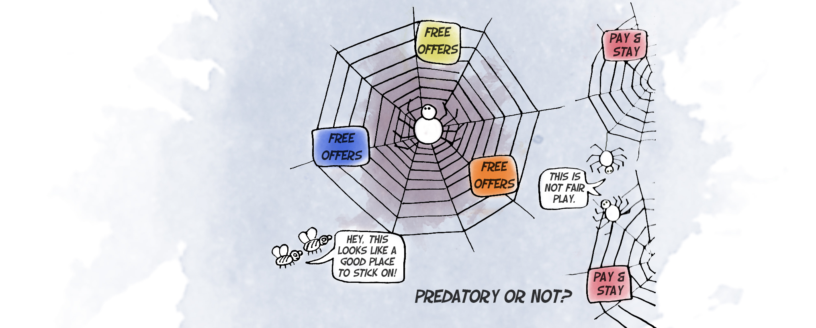
Predatory pricing
A dominant firm sets prices too low for a sufficient period so that competitors leave the market and others are deterred from entering
Expectation is that the losses incurred can be compensated by future gains
Predatory pricing causes harm to consumers and is considered anti-competitive

Slide 48
Going rate pricing
Following the prevailing market price instead of a separate marketing strategy
Prices are mostly fixed by dominant firm & others accept it
Adopted when the products sold by other sellers are close substitutes and cross elasticity is very high
Used when product has reached maturity and become generic i.e. the buyer will now not ask for a specific brand , but just ask for the product in general e.g. mineral water

Slide 49
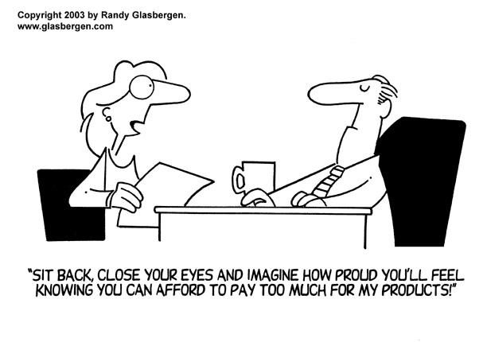
Price skimming
High price is charged at introduction of product and a lower price during maturity
Producers aware that high income consumers want to be among the first owners (status symbol)
Sellers skim the market and earn a very high profit at launch
Once established, and reached
maturity, charge lower price to
attract lower income group

